Slide 1
Computer Programming
Sino-European Institute of Aviation Engineering

Slide 2





Module 10
Ada Programming Language

Slide 3
Outline
Overview of Ada Language
Ada Syntax
Data Types
Types of Statements
Subprograms
Package
Input and Output

Slide 4
Overview of Ada Language
Application Language
High-level Language
Easy to understand, use, portable,
compiled, less efficient
Efficient, hard to use, machine
dependent, not portable
Assembly Language
Machine Language
Hardware

Slide 5
Overview of Ada Language
What’s Ada
Ada is an international standard, it is a structured, statically typed, imperative, wide-spectrum, and object-oriented high-level computer programming language, extended from Pascal and other languages.
It has built-in language support for explicit concurrency, offering tasks, synchronous message passing, protected objects, and non-determinism.

Slide 6
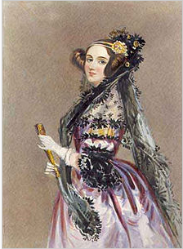
Overview of Ada Language
History of Ada
Ada was originally designed by a team led by Jean Ichbiah of CII Honeywell Bull under contract to the United States Department of Defense (DoD) from 1977 to 1983 to supersede the hundreds of programming languages then used by the DoD.
Ada was named after Ada Lovelace (1815–1852), who is credited as being the first computer programmer.

Slide 7
The development of Programming language
1960 Algol-60
1950
Fortran
1963 CPL
1960
Algol-60
Cobol
1967 BCPL
CPL
Simula
BCPL
1970
B
1970
Pascal
B
Smalltalk
C
1972
C
1980
Ada
C++
1985
C++
ANSI C
1990
Java
Notes:
C的前辈语言：Algol68，CPL，BCPL，B。
1960年1月，图灵奖获得者:艾伦.佩利（Alan J.Perlis）在巴黎举行的有全世界一流软件专家参加的讨论会上，发表了“算法语言Algol 60报告”，确定了程序设计语言的基础。
CPL（Combined Programming language，组合编程语言)：CPL是一种在ALGOL60基础上更接近硬件的一种语言。CPL规模大，实现困难。 BCPL（Basic Combined Programming language，基本的组合编程语言）：BCPL是对CPL进行简化后的一种语言。
B语言大约是于1969年时由美国贝尔实验室的电脑科学家肯·汤普森在丹尼斯·利奇的支持下设计出来的。
丹尼斯·利奇以B语言为基础开发出C语言
ANSI（Americal national standard institute）：美国国家标准化组织。
计算机语言按照使用方式和功能分为低级语言和高级语言。
低级包括机器语言和汇编语言。
机器语言是计算机指令的集合，是第一代计算机语言。
汇编语言用符号来表示计算机指令，是第二代计算机语言。
二者都是面向机器的语言。
用自然语言的形式描述对问题的处理过程，用数学表达式的形式描述对数据的计算过程。高级语言，不关心计算机的内部机构，面向过程的语言，如Basic, Fortran, Cobol, C, Pascal.告诉计算机怎么做。
第四代非过程化语言，只需告诉计算机做什么，是面向对象的语言。
第五代智能语言

Slide 8
Overview of Ada Language
the current version (known as Ada 2012) is defined by ISO/IEC 8652:2012.
Ada 95
Strong typing / run-time checking
Parallel processing / exception handling / generics
Originally targeted for embedded and real-time systems
Now include aerospace and safety-critical systems

Slide 9
Overview of Ada Language
Use of Ada Around the World
The control software of nearly every new commercial aircraft model, including the Boeing 777, the Airbus 340, and many regional airlines
Nearly every country’s air traffic control system
A number of communications and navigational satellites and ground-based equipment

Slide 10
Overview of Ada Language
Contrast: Ada and C,C++
Ada was originally targeted at embedded and real-time systems
Improve support for systems, numerical, financial, and object-oriented programming (OOP)
A large number of compile-time checks are supported to help avoid bugs that would not be detectable until run-time in some other languages.

Slide 11
Overview of Ada Language
Contrast: Ada and C,C++
Ada also supports run-time checks to protect against access to unallocated memory, buffer overflow errors, range violations, off-by-one errors, array access errors, and other detectable bugs.
Ada's dynamic memory management is high-level and type-safe.
it has the stronger portability and compatibility than C

Slide 12
Overview of Ada Language
Resources
GNAT 3.15p (Free Software Foundation)
AdaGide (US Air Force Academy)
http://www.adahome.com/
http://www.adapower.com/
http://www.adaic.com/
http://gcc.gnu.org/onlinedocs/gnat_rm/
http://www.adahome.com/rm95/rm9x-toc.html

Slide 13
Overview of Ada Language
A Simple Program: Hello World
package
Include
with Ada.Text_IO;
procedure Hello is
--------------------------------------------------------------------------------------
--| A very simple program; it just displays a greeting.
--| Last Modified: July 2014
--------------------------------------------------------------------------------------
begin-- Hello
Ada.Text_IO .Put("Hello World. ");
Ada.Text_IO .New_Line;
end Hello;
hello.adb

Slide 14
Overview of Ada Language
A Simple Program: Hello World
with Ada.Text_IO; use Ada.Text_IO;
procedure Hello is
--------------------------------------------------------------------------------------
--| A very simple program; it just displays a greeting.
--| Last Modified: July 2014
--------------------------------------------------------------------------------------
begin-- Hello
Put("Hello World. ");
New_Line;
end Hello;
hello.adb
Str:String := "Hello World";
Put(Str)

Slide 15
Overview of Ada Language
GNAT Compiler
The US Air Force funded the development of the GNAT Compiler, which is part of the GNU Compiler Collection (GCC).
It is the only Ada compiler that supports all of the optional annexes of the language standard.
GNAT is always licensed under the terms of the GNU General Public License.

Slide 16
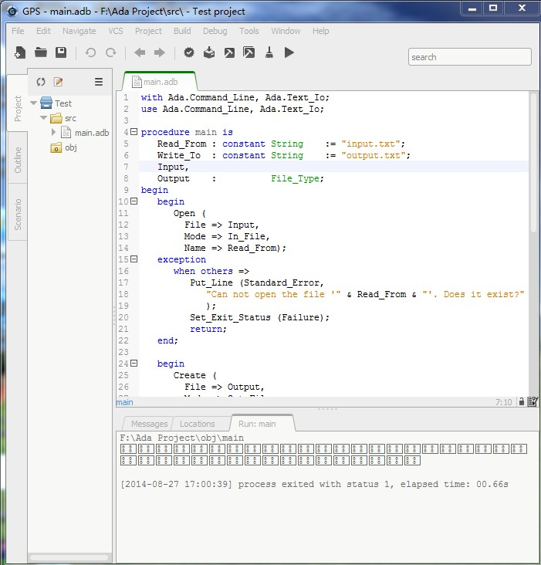
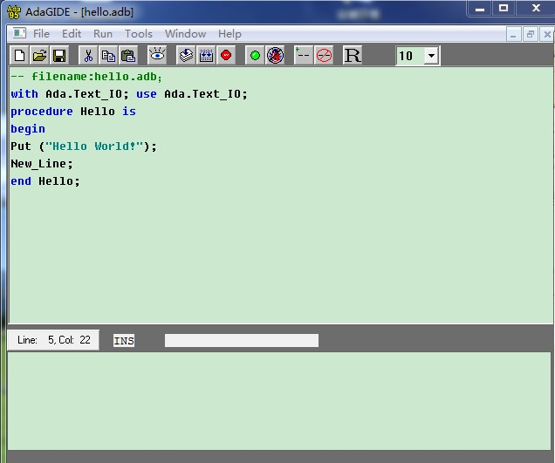
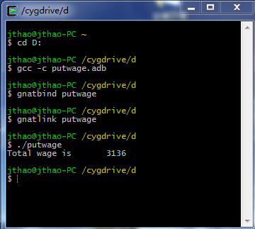
Overview of Ada Language
GNAT Compiler
GNAT Programming Studio（GPS）
GNAT Ada 95 Complier
Cygwin/ MINGW

Slide 17
Overview of Ada Language
Three steps are needed to create an executable file from an Ada source file
The source file(s) must be compiled.
The file(s) must be bound using the GNAT binder.
All appropriate object files must be linked to produce an executable.

Slide 18
Overview of Ada Language

Slide 19
Overview of Ada Language
Common Programming Errors
Compilation errors
Run-time errors
Logic or algorithmic errors

Slide 20
Overview of Ada Language
Compilation Errors
Syntax errors
Fatal error that has to be fixed before code can be
compiled
Propagation errors
Semantic errors
Inconsistency in the use of values, variables,
packages, …
Correct the first one or two errors in program, then recompile

Slide 21
Overview of Ada Language
Run-time Errors
Detected during execution of a program called exception in Ada
In Ada we have a way of predicting the occurrence of exceptions and prevent the computer from halting
Exception handling

Slide 22
Overview of Ada Language
Logic / Algorithm Errors
Developing an incorrect algorithm for solving a problem
Incorrect translation of a correct algorithm
The computer does only what you tell it to do,not what you meant to tell it to do …(GIGO)

Slide 23
Overview of Ada Language
Comments, headers, and programming style
Good programming style:
Communication
Good style leads to programs that are:
❑
Understandable, readable, reusable, efficient,
easy to develop and debug

Slide 24
Overview of Ada Language
Comments, headers, and programming style
Comments start with “--” and are ignored by the compiler
------------------------------------
-- program name: my_first_program
-- programmer: Jane B
-- usage:
-- compile:
-- system:
-- date: started 9/5/03
--
phase 1 complete 9/8/03
-- bugs:
-- description:
-----------------------------------

Slide 25
Overview of Ada Language
Exercise1
Modify the “Hello” program to display the following text on the screen
Hello World
My name is Your Name

Slide 26

Overview of Ada Language
Adventures of the Spider-Introduce to algorithms
Simple picture-drawing creature – The Spider
Algorithmic constructs
(control structures and parameters)
Ada packages

Slide 27
Overview of Ada Language
Straight-Line Algorithms-The Spider walks a line
Spider commands with parameters
TYPE Directions IS (North, East, South, West);
TYPE Colors IS (Red, Green, Blue, Black, None);
PROCEDURE Face (WhichWay: IN Directions);
Spider.Face(WhichWay => Spider.West);
Enumeration types: provides lists of values
--Pre: WhichWay has been assigned a value
--Post: Spider turns to face the given direction.
PROCEDURE ChangeColor (NewColor: Colors);
Spider.ChangeColor(NewColor => Spider.Red);
--Pre: NewColor has been assigned a value
--Post: Spider leaves its tracks in the new color.

Slide 28
Overview of Ada Language
Algorithm with single loop-Drawing a box
Repeat steps 1 and 2 four times
1. Take three steps forward
2. turn right
A repetition usually called a Loop
FOR Side IN 1..4 LOOP
….
END LOOP;

Slide 29
Overview of Ada Language
Algorithm with Nested loop- Drawing a box
Repeat steps 1 through 3 four times
1. Choose a color
2. Repeat step 2.1 three times
2.1Take one step forward
2. turn right
FOR Side IN 1..4 LOOP
Spider.ChangeColor(Spider.RandomColor);
FOR Count IN 1..5 LOOP
Spider.Step;
END LOOP;
Spider.TurnRight;
END LOOP;

Slide 30
Overview of Ada Language
Conditional execution
FUNCTION AtWall RETURN Boolean;
-- Pre: None
-- Post: Return True if the spider is standing
--next to a wall
IF Spider.AtWall THEN
EXIT;
END IF;

Slide 31
Overview of Ada Language
Exercise2
Write an algorithm to use the Feldman “spider package” to draw an inverted triangle as shown below.
RRRRRRR
R R
R R
R

Slide 32
Ada Syntax
General structure of Ada programs
with ...;
----------------------------------
-- header
--------------------------------- -
procedure program_name is
declare constants & variables used
Begin -- program_name
statements
end program_name;

Slide 33
with Ada.Text_Io;
procedure Hello_Name is
------------------------------------------------------------------
--------------------
--|Requests, then displays, user's name
--| --| Last Modified: July 2014
--------------------------------------------------------------------------------------
FirstName: String(1..10); -- object to hold user's name
begin -- Hello_Name
-- Prompt for (request user to enter) user's name
Ada.Text_IO.Put
(Item => "Enter your first name, exactly 10 letters.");
Ada.Text_IO.New_Line;
Ada.Text_IO.Put
(Item => "Add spaces at the end if it's shorter.> ");
Ada.Text_IO.Get(Item => FirstName);
-- Display the entered name, with a greeting
Ada.Text_IO.Put(Item => "Hello ");
Ada.Text_IO.Put(Item => FirstName);
Ada.Text_IO.Put(Item => ". Enjoy studying Ada!");
Ada.Text_IO.New_Line;
end Hello_Name;

Slide 34
Ada Syntax
Modules
Procedure
Abstracts an operation
Package
Collects related operations and data types

Slide 35
Ada Syntax
Advantages of modules
Procedure
Functional abstraction
Top-down development
Reduced complexity
Parallel development
Avoid duplication
Package
Shared resources
Improved productivity
Improved quality

Slide 36
Ada Syntax
Package
Collection of resources
Encapsulated in one unit
Ex: Text_IO, Calendar, user-defined packages
Collection of types and constants
Group of related subprograms
User defined types and allowable operation

Slide 37
Ada Syntax
Character Set
Graphic character
Letter
Digit
Space
Special characters (# & ' ( ) * + , - . / : ; < = > _ | { } [ ])
Format character
HT( Horizontal tab)
VT（Vertical tab）
CR（Carriage return）
LF（Line feed）
Other control function

Slide 38
Ada Syntax
Identifiers
Wrong:
Fig_
_Lik
2me
__hello
Begin with letters
_ can’t be the end
two_ can’t appear continuously
can’t be reserved words

Slide 39
Ada Syntax
Reserved words
abort abs accept access all and array at begin
body case constant declare delay delta digits else
elsif end entry exception exit for function generic
goto if in is limited loop mod new not null of or
others out package pragma private procedure
raise range record rem renames return reverse
select separate subtype task terminate then type
use when while with xor

Slide 40
Ada Syntax
Pre-defined words
Boolean Character Close Create Delete False
Float Get Integer Natural New_Line Open Put
Put_Line Positive Read Reset Skip_Line String
Text_Io True Write

Slide 41
Ada Syntax
Layout conventions
Common layout convention makes programs easier for others to read, understand (and mark!)
Basic conventions
One statement (one thought) per line
Break long lines into readable segments
Indent lines to show different parts of program
Blank lines separate parts of the program
Comments help readers understand program

Slide 42
Ada Syntax
-- Comments
Minimum comments in any program:
the name of the program
who wrote it and when
description of what the program does
description of any constants or variables
description of purpose of each segment of code
assumptions made (precondition / postcondition)

Slide 43
Ada Syntax
Pragmas
Compile Directive, some pre-defined commands
pragma List(identifier);
pragma Page;
pragma Optimize(identifier);
On or Off
listing of compilation
Time, Space or Off

Slide 44
Data Types
A variable has a
Name
An Identifier
What does the variable represent ?
Data type
What values can the variable have?
What operations can be performed on it?

Slide 45
Data Types
Type
A set of values
A set of primitive operations
Grouped into classes based on the similarity of values and primitive operations
Elementary types
Composite types

Slide 46
Data Types
Constants are data values that does not change
Name : constant Type := Value;
Answer : constant String := "forty two";
Medicare_Rate : constant Float := 1.4;
Pi : constant Float := 3.1415926536;

Slide 47
Data Types
Ada has strong typing
-3 + 4
3.0 / 4.0
1.0 > 0
3 * 4.0
Mixed arithmetic: must convert one type to another
1.0 > FLOAT(0)
FLOAT(3) * 4.0
3 * INTEGER(4.0)

Slide 48
Data Types
Variable declaration
variable_name : type;
variable_name :constant type;
Var_1: Integer;
Var_1 : Integer range 1..10;
Initialzation
variable_name : type:=value;
variable_name :constant type := value;
Var_1: Integer:=1;
Var_1 : Integer range 1..10:=2;
Cons2 :constant := 8;

Slide 49
Expressions and Operators
Classification
Logical Operators： and、or、xor
Relational Operators ： =、/=、<、>、<=、>=
Arithmetic Operators：+，-,&,*,/,rem,mod
Boolean,Modular
Highest precedence：**, not, abs

Slide 50
Data Types
Arithmetic
unary minus (negation)
absolute value
-int_val
abs int_val
23 / 4 = 5
23 rem 4 = 3
-23 mod 4 = 1
2 ** 4 = 16
+ - * / mod rem **
division
remainder
modulus
exponentiation
Relational
= /= < > <= >=

Slide 51
Data Types
Example
X /= Y
"" < "A" and "A" < "Aa
"Aa" < "B" and "A" <"A "
My_Car = null;
My_Car = Your_Car
N not in 1..10
Today in Mon..Fri
"A"&"B" = "AB"
A = (A/B)*B + (A rem B);
A = B*N + (A mod B);

Slide 52
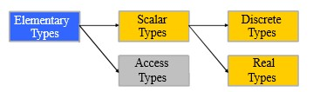
Data Types
Type Classification
Elementary Types : Values are logically indivisible
Composite Types : Values composed from components

Slide 53
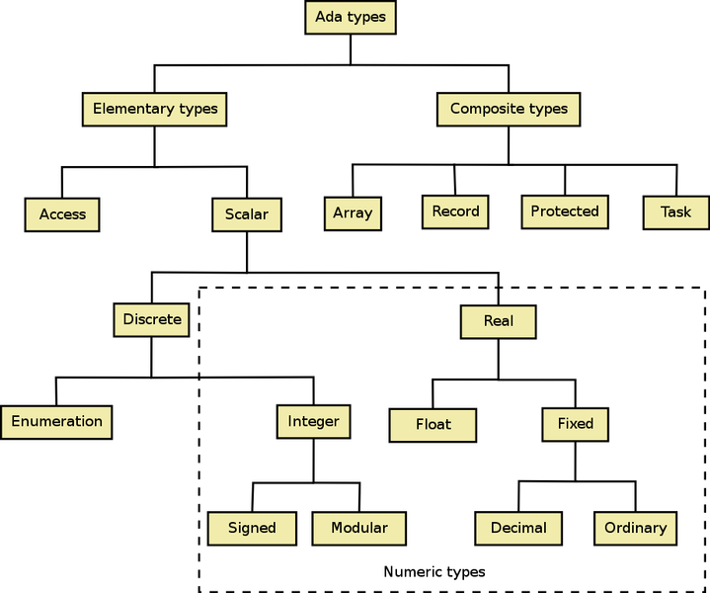
Data Types

Slide 54
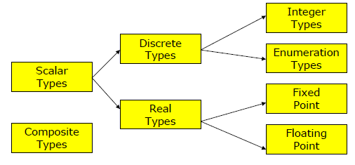
Data Types
Scalar Types
Ordered → relational operators are defined
Each value of a discrete type has a position number

Slide 55
Data Types
Integer Types
Positive or negative number with no decimal part
Integer
Short_Integer
Short_Short_Integer
Long_Integer
Long_Long_Integer
354
-52689
+4432
Range of integers
Integer’First :smallest integer on given system
Integer’Last :largest integer on given system
Put ("The lowest integer value is: ");
Put (Integer'First); New_Line;

Slide 56
Data Types
Modular type (unsigned int)
type type_name is mod range_specification
0..range_specification - 1
Byte type
type Byte is mod 256
0 .. 255

Slide 57
Data Types
Write an algorithm to
Accept the weight of the user (in kilograms)
Compute the equivalent weight in pounds
Display:
Hint: 1 pound = 0.453592 kilograms.

Slide 58
Data Types
Boolean Type
type Boolean is (True, False);
True is not equal to 1;
Enumeration Type
A data type whose values are a collection of allowed words
type type_name is (elememt_list)；

Slide 59
Data Types
Enumeration Types
type Class is (Freshman, Sophomore, Junior, Senior);
type days is (Mon, Tue, Wed, Thu, Fri, Sat, Sun);
type colours is (white, red, yellow, green, blue, pink,black);
type traffic_colours is (green, yellow, red);
type suits is (clubs, diamonds, hearts, spades);

Slide 60
Data Types
Benefits of Enumeration Types
readable programs
avoid arbitrary mapping to numbers, e.g. better to use "Wed" than 3 for a day of the week
they work well as selectors in case statements

Slide 61
Data Types
Attributes of Enumeration Types
type Days is (Monday, Tuesday, Wednesday, Thursday, Friday,
Saturday, Sunday);
Today : Days; --current day of the week
Tomorrow : Days; --day after Today
Today := Friday;
Tomorrow := Saturday;
Days’First is Monday
Days’Last is Sunday
Days’Pos(Monday) is 0
Days’Val(0) is Monday
Days’Pred(Wednesday)is Tuesday
Days’Succ(Today) is Saturday
You must ensure the result is legal.
A CONSTRAINT_ERROR will occur at run-time otherwise.
For example,
days'SUCC(Sun) is illegal.

Slide 62
Data Types
Operations on Discrete Types
S’Pos(Arg) returns the position number of the argument
S’Val(Arg) a value of the type of S whose position number equals the value of S

Slide 63
Data Types
Floating point
Float，Short_Float，Short_Short_Float，Long_Float，Long_Long_Float
type type_name is digits number [range range_specification] ;
Range: -10.0**(4*D) .. +10.0**(4*D)
type Real is digits 8;
type Mass is digits 7 range 0.0 .. 1.0E35;
subtype Probability is Real range 0.0 .. 1.0;
-10.0E32 .. +10.0E32

Slide 64
Data Types
Fixed point
Normal
type type_name is delta delta_number_range range_specification
Decimal
type type_name is delta delta_number digits digit_number [range range_specification]；
-(10**digits-1)*delta..+(10**digits-1)*delta
type Volt is delta 0.125 range 0.0..255.0;
type Fraction is delta System.Fine_Delta range -1.0..1.0;
type Money is delta 0.01 digits 15;
subtype Salary is Money digits 10;

Slide 65
Data Types
Attributes of Scalar Types
S’First denotes the lower bound of the range of S. The value of this attribute is of the type of S.
S’Last denotes the upper bound of the range of S
S’Range is equivalent to the range S’First ..S’Last

Slide 66
Data Types
Operations on Scalar Types
S’Min returns lower of two elements
S’Max returns higher of two elements
S’Value accepts a string and returns the value in the type
S’Image converts the value into a string
S’Pred and S’Succ – behavior depends on the scalar type
S’Pred (Integer) : returns (Integer -1)
S’Succ (Integer) : returns (Integer + 1)

Slide 67
Data Types
Subtypes
A subtype is a subrange of a larger type.
Subtypes of the same larger type are not distinct types.
A subtype and the larger type are also not distinct types. Thus subtypes of the same thing are assignment-compatible.
The benefit of subtypes is that range checks avoid some nonsense.

Slide 68
Data Types
Subtype Example
Two useful sub-types of the integers are built into Ada:
subtype POSITIVE is INTEGER range 1..INTEGER'LAST;
subtype NATURAL is INTEGER range 0..INTEGER'LAST;

Slide 69
Data Types
Subtype Example
min_on_bus:constant := 0;
max_on_bus:constant := 80;
type no_on_buses is range min_on_bus ..max_on_bus;
max_seated : constant no_on_buses := 50;
subtype seated_on_buses is no_on_buses range
min_on_bus .. max_seated;
subtype standing_on_buses is range min_on_bus ..
(max_on_bus - max_seated);

Slide 70
Data Types
Subtype
Subtype Example
subtype
subtype
subtype
subtype
subtype
Natural is Integer range 0..Integer’Last;
Positive is Integer range 1..Integer’Last;
NonNegativeFloat is Float range 0.0 .. Float’Last;
SmallInt is Integer range -50..50;
CapitalLetter is Character range ’A’..’Z’;
X, Y, Z : SmallInt;
NextChar : CapitalLetter;
Hours_Worked : NonNegFloat ;
X := 25;
Y := 26;
Z := X + Y; -- Exception raised

Slide 71
Data Types
Derived Types
age := -20;
height := age - class_size;
shoe_size := 2 * no_on_bus;
Types help program values reflect the real
world.

Slide 72
Data Types
Derived Interger Types
New data types can be derived from INTEGER:
type ages is new INTEGER range 0 .. 110;
age : ages;
voting_age : constant ages := 18;
type heights is range 0 .. 230;
height : heights;
min_enrolment : constant := 6;
max_enrolment : constant := 200;
type class_sizes is range 0..max_enrolment;
class_size : class_sizes;

Slide 73
Data Types
Benefits of derived types
Nonsense rejected by compiler
height := age - class_size;
"Out of range" rejected by compiler
age := -20;
“Out of range” run time error
class_size := class_size + 100;
Enforce distinct nature of different objects
Robust, elegant, effective programs

Slide 74
Data Types
Type Conversion
Ada has strong typing: different types cannot be mixed
Explicit type conversion is permitted:
type length is digits 5 range 0.0 .. 1.0E10;
type area is digits 5 range 0.0 .. 1.0E20;
function area_rectangle (L,H : length) return area is
begin
return area(L) * area(H);
end;

Slide 75
Array
Static structure of fixed size
lb: low bound
ub: upper bound
Index<lb | index >up : constraint error
type My_Array is array (1 .. 10) of Integer;
lb
ub

Slide 76
Array
Definition
type array_name is array (index specification) of type;
type Total is range 1 .. 100;
-- Total’s type is integer, range is 1..100。
type Wages is array (Total) of Integer;
-- declaration of array (Wages) which has 100 Integer elements.
type Wages is array (1 .. 100) of Integer;

Slide 77
Array
Definition
type First_Name is( Bill, Jack, Tom );
type Enrollment is array ( First_Name ) of Integer;
Var : Enrollment;
-- Array Var has 3 Integer elements: Var (Bill),Var (Jack),Var (Tom)
type NO is array (-5 .. 100) of Integer;
X : NO;
-- Array X has 105 Integer elements ，the first one is X (-5)，and the last one is X (100)。

Slide 78
Array
Definition with aliased elements
We can packed the array, then more than one element may share one address
type Day_Of_Month is range 1 .. 31;
type Day_Has_Appointment is array (Day_Of_Month) of Boolean;
pragma Pack (Day_Has_Appointment);
If we need to address each single element, Just not using pragma is not enough
type Day_Of_Month is range 1 .. 31;
type Day_Has_Appointment is array (Day_Of_Month) of aliased Boolean;

Slide 79
Array
Unconstrained Array
we use the box '<>', which allows us to declare indefinite arrays:
array (Index_Type range <>) of Element_Type;
When you declare objects of such a type, the bounds of course must be given and the object is constrained to them.
The predefined type String is such a type. It is defined as
type String is array (Positive range <>) of Character;

Slide 80
Array
Dynamic Array
the range actually needed is not known until runtime
X : Positive := Y;
Var : array (1 .. X) of Integer;
Not safe
procedure Demo (Item :string) is
copy : String (Item'First..Item'Last) := Item;
double: String(1..2*Item'Length) := Item & Item;
--Item'First, Item'Last is the attributes of array ,& Concatenates two strings

Slide 81
Array
Multidimensional Array
Arrays have more than one index
type Character_Display is
array (Positive range <>, Positive range <>) of Character;
Magic_Square: constant Character_Display(1 .. 5, 1 .. 5) :=
(1 => ('S', 'A', 'T', 'O', 'R'),
2 => ('A', 'R', 'E', 'P', 'O'),
3 => ('T', 'E', 'N', 'E', 'T'),
4 => ('O', 'P', 'E', 'R', 'A'),
5 => ('R', 'O', 'T', 'A', 'S'));

Slide 82
Array
Operations on Arrays
Assignment
Vector_A (1 .. 3) = Vector_B (3 .. 5)
Vector_A (1 .. 3) := Vector_B (3 .. 5);
False
Concatenate (using”&”)
Name := First_Name & ' ' & Last_Name;
Access
type Wages is array (1 .. 100) of Integer;
Wages(2)>Wages(1)

Slide 83
Array
Array Attributes
1-D
N-D
A'First : Low bound
A'Last: upper bound
A'Range :A'First .. A'Last
A'Length: num of elements
A'First(N) : Low bound of Nth index
A'Last(N) : Low bound of Nth index
A'Range(N) : A'First(N) .. A'Last(N)
A'Length(N): num of elements of Nth index
Length : array (1..10) of Integer;
Length'First = 1;
Length'Last = 10;
Length'Range = 1..10;
Length'Length = 10;
Rectange : Matrix (1..20,1..30);
Rectange'First (1) = 1; Rectange'Last (1) = 20;
Rectange'First (2) = 1; Rectange'Last (1) = 30;
Rectange'Length (1) = 20;
Rectange'Length (2) = 30;
Rectange'Range(1) =1.. 20;
Rectange'Range (2) = 1..30;

Slide 84
Array
Array Attributes
1-D
N-D
A'First : Low bound
A'Last: upper bound
A'Range :A'First .. A'Last
A'Length: num of elements
A'First(N) : Low bound of Nth index
A'Last(N) : Low bound of Nth index
A'Range(N) : A'First(N) .. A'Last(N)
A'Length(N): num of elements of Nth index
Length : array (1..10) of Integer;
Length'First = 1;
Length'Last = 10;
Length'Range = 1..10;
Length'Length = 10;
Rectange : Matrix (1..20,1..30);
Rectange'First (1) = 1; Rectange'Last (1) = 20;
Rectange'First (2) = 1; Rectange'Last (1) = 30;
Rectange'Length (1) = 20;
Rectange'Length (2) = 30;
Rectange'Range(1) =1.. 20;
Rectange'Range (2) = 1..30;

Slide 85
Character and String
Character
Character: correspond to the 256 code positions of row 00 (also knows as Latin-1) of the ISO 10646 Basic Multilingual Plane(BMP)
Package:Ada.Characters.Latin_1
Wide_Character: correspond to the 65536 code positions of the ISO 10646 Basic Multilingual Plane(BMP)
Package: Ada.Characters.Wide_Latin_1
Processing Functions:
Package: Ada.Characters.Handling

Slide 86
Character and String
Character Classification

Slide 87
Character and String
Character Handling
function To_Lower (Item : in Character) return Character;
function To_Upper (Item : in Character) return Character;
function Is_Character (Item : in Wide_Character) return Boolean;
subtype ISO_646 is Character rangeCharacter'Val(0)..Character'Val(127);

Slide 88
Character and String
String
Used when representing a sequence of characters as a single unit of data
subtype Positive is Integer range 1 .. Integer'Last;
type String is array (Positive range <>) of Character;
type Wide_String is array (Positive range <>) of Wide_Character;

Slide 89
Character and String
String
How many characters?
String (1 .. Maxlen);
Max_Str_Length : constant := 26;
Alphabet, Response:String(1..Max_Str_Length);

Slide 90
Character and String
String Operations
Assignment
Alphabet := “abcdefghijklmnopqrstuvwxyz ”
Response := Alphabet;
Concatenation (&)
Alphabet(1..3) & Alphabet(26..26)
Put(Item => “The alphabet is “ & Alphabet & “.”);

Slide 91
Character and String
Character and String
String Operations
append: adds a character to the end of a string
insert: inserts a string in the middle of another string
delete: deletes part of a string
concatenate: joins two strings together
substring: returns part of a string
find: returns the position at which one string occurs within another, or whether it exists
Length: return the number of characters in a string
equals: tests two strings for equality

Slide 92
Character and String
Sub-Strings
Individual character: specify position
alphabet(10)
alphabet(17)
'j'
'q'
Slice: specify range of positions
alphabet(20..23)
alphabet(4..9)
tuvw"
defghi"
Assign to compatible slice
response(1..4) := "FRED";
response "FREDefghijklmnopqrstuvwxyz"

Slide 93
Record Type
What’s an access type?
Structure in C
A record is a composite type that groups one or more field
type record_name is
record
field name 1: type 1;
field name 2: type 2;
...
field name n: type N;
end record;
type Id_Card is
record
Full_Name : String (1..15);
ID_Number : Positive;
Age : Positive;
Birthday : String (1..15);
Familiy_Address : String (1..15);
Family_telephone : Positive;
Job : String(1..10);
end record;
My_Card :Id_Card;

Slide 94
Record Type
Access and Set Records
My_Card.Full_Name := "Jack Welch ";
My_Card := ( Full_Name => "Jack Welch ",
ID_Number => 19830519,
Age => 45,
Birthday => "Jan 1st 1976 ",
Familiy_Address => "China ",
Family_telephone => 8127271;
Job => "CEO ") ;
ID_Number | Family_telephone => 19830519,

Slide 95
Record Type
Variant Record
type Id_Card (Age : Positive := 1) is
record
Full_Name : String(1..15）;
ID_Number : Positive;
Birthday : String(1..15);
Familiy_Address : String(1..15);
Family_telephone : Positive;
Job : String(1..10);
case Age is
when 1 .. 18 => School_Address : String(1..15);
when 19 .. 60 => Monthly_Income : Integer;
Working_Address: String(1..15);
when others => null;
end case;
end record;
My_Card : Id_Card ；--Declaration will be illegal if Age is not initialized.
Your_Card: Id_Card (Age => 20);

Slide 96
Access Type
Dynamic Data Structure
Arrays have disadvantages:
size must be known at compile time
space wasted or insufficient (overflow)
inserting to/removing from middle requires shifting the elements
Idea: Use dynamic, variable sized memory (linked lists)
size starts at zero, changes as necessary
space (de)allocated by programmer
access variables needed Declaration

Slide 97
Access Type
Linked Lists
a list of nodes (records), each pointing to the next node
List data type:
insert/delete anywhere
sequence of nodes
implement using linked memory

Slide 98
Access Type
What’s an access type?
Access types in ada are what other languages call pointers
Declaration
type new_type_name is access [all] type_name；
type List_Node is
record
Data : Integer;
end record;
type List_Node_Access is access List_Node;
Current :List_Node_Access;

Slide 99
Access Type
Operation on Access type
Create an object
Current := new List_Node;
Root:=new List_Node;
C: malloc
C++: new
Initialize the object
Current := new List_Node'(1);
Root := new List_Node'(Data =>2);

Slide 100
Access Type
Operation on Access type
Current.Data := 1;
Root.Data:=2;
Access the object
If the object is a record; to access a field:
P.fieldname
to access the entire object pointed to by P
P.all
If the object is an array; to access an element:
P(i)
CONSTRAINT_ERROR if P has value null
P is not affected when the object is accessed

Slide 101
Access Type
type List_Node;
type List_Ptr is access List_Node;
type List_Node is
record
Element : Element_Type;
Next : List_Ptr;
end record;
type List is
record
Head : List_Ptr;
end record;
Define a node
Define a record type
Define an access type

Slide 102
Access Type
procedure Initialize (L : in out List) is
begin
L.Head := null;
end Initialize;
procedure List_Test is
My_List : List;
Element : Element_Type;
begin
Initialize(My_List);
Add_To_Front(My_List, 6);
Add_To_Front(My_List,12);
Add_To_Front(My_List,98);

Slide 103
Types of Statements
Input/Output libraries
Text:
Integer:
Float:
Own type:
Ada.Text_Io
Ada.Integer_Text_Io
Ada.Float_Text_Io
define new library
package type_io is new
TEXT_IO.basetype_io (typename);

Slide 104
Types of Statements
Input/Output libraries
type Colors is(white, black, red, purple);
package Color_Io is
new Ada.Text_Io.Enumeration_Io (Enum => Colors);
One_Color : Colors;
begin -- procedure_name
Color_Io.Get (Item => One_Color);

Slide 105
Types of Statements
Input
Get (argument)
Argument is a variable that receives input values
Value must be same type (e.g., integer) as variable
Put (Item => “Please enter the first number: “);
Get (Item => Number1);

Slide 106
Types of Statements
Skip_Line
Advance to next line, ignoring unused input
When prompting for values from a user, always follow Get with Skip_Line
Put (Item => “Please enter the first number “);
Get (Item => Number1); Skip_Line;
Put (Item => “Please enter the second number “);
Get (Item => Number2); Skip_Line;
Please enter the first number 42 10
Please enter the second number 23

Slide 107
Types of Statements
Output
Put (argument)
Print argument
Leave the cursor on the same line
Put(Item => “Please enter the first number: “);
Get(Item => Number1); Skip_Line;
Please enter the first number: 42

Slide 108
Types of Statements
Formatted output
Put ("The sum of the numbers is:");
Put (Number1+Number2, Width=>7); New_Line;
Put ("The product of the numbers is:");
Put (Number1*Number2, Width=>3); New_Line;
Put ("The sum of the numbers is:");
Put (Number1+Number2, Width=>1); New_Line;
The sum of the numbers is: 14
The product of the numbers is: 48
The sum of the numbers is:14

Slide 109
Types of Statements
Put (23.456);
Put (23.456, Exp=>0);
Put (23.456, Aft=>3, Exp=>0);
Put (23.456, Aft=>2, Exp=>0);
Put (23.456, Fore=>3, Aft=>3, Exp=>0);
' 2.34560000000000E+01'
'23.45600000000000'
'23.456'
'23.46'
'23.456'

Slide 110
Types of Statements
type Days is (Monday, Tuesday, Wednesday,
Thursday, Friday, Saturday, Sunday);
package Day_IO is new
Ada.Text_IO.Enumeration_IO(Enum=>Days);
Day_IO.Get(Item => Today);
Day_IO.Put(Item => Today, Width => 10);
if Today in weekend_days then
put(”Holliday!”);
end if;

Slide 111
Types of Statements
Exercise
Write an Ada95 program to accept a date in the Date/Month/Year format. Accept each of the inputs separately. Display the date in all three formats as shown below:
19/9/2014
19 September 2014
19.9.2014

Slide 112
Types of Statements
Assignment
Perform calculation and save result in a variable
Total_Num := Number1 + Number2;

Slide 113
Types of Statements
Control Structures-Selection statements
Ada provides two types of selection statements
IF statements
if-then, when a single action might be done
if-then-else, to decide between two possible actions
if-then-elsif, to decide between multiple actions
Case statements
also for deciding between multiple actions

Slide 114
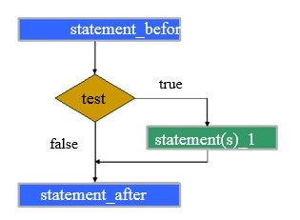
Types of Statements
If-then statements
statement_before;
if test then
statement(s)_1;
end if;
statement_after;

Slide 115
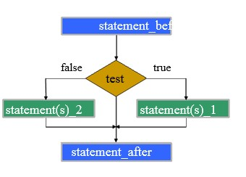
Types of Statements
If-then-else statements
statement_before;
if test then
statement(s)_1;
else
statement(s)_2;
end if;
statement_after;

Slide 116
Types of Statements
Multiple Selections
statement_before;
if test_1 then
statement(s)_1;
elsif test_2 then
statement(s)_2;
else
statement(s)_3;
end if;
statement_after;

Slide 117
Types of Statements
Example
Act differently depending on balance in account after withdrawal
Balance after withdrawal | Action
>= 0 | Accept withdrawal
>= -50 and < 0 | Overdraft
< -50 | Refuse withdrawal

Slide 118
Types of Statements
Alternative user interfaces
Enter balance of the account 100
Enter the withdrawal 50
Accepted. Balance is 50
Enter balance of the account 76
Enter the withdrawal 150
Refused! Balance is 76
Enter balance of the account 50
Enter the withdrawal 75
Overdraft! Balance is -25

Slide 119
Types of Statements
if_then_elsif
NAME | TYPE | Notes
Overdraft_Limit | Integer | -50 (for ease of change)
Zero | Integer | 0 (for readability only)
Balance | Integer | Balance in the account
Withdrawal | Integer | Amount requested by user
Resulting_Balance | Integer | Balance after withdrawal

Slide 120
Types of Statements
Data Requirements and Formulas
Problem Constant
Overdraft_Limit :constant Integer := -50;
Zero: constant Integer :=0;
Problem inputs
Balance --balance on account
Withdrawal -- amount to withdrawal from account
Problem outputs
Resulting_balance- Balance after withdrawal
Formulas or relations
Resulting_balance- Balance - withdrawal

Slide 121
Types of Statements
Algorithm
Get balance and withdrawal
Get balance / Get withdrawal
Calculate resulting balance
New balance = old balance – withdrawal
If new balance is >= zero, then
Indicate transaction accepted
else if new balance between zero and overdraft limit
Indicate overdraft is used
else
Indicate transaction rejected

Slide 122
Types of Statements
Conditions
NOT(TRUE) | FALSE
NOT(FALSE) | TRUE
NOT
F or F | F
F or T | T
T or F | F
T or T | T
OR

Slide 123
Types of Statements
Conditions
F and F | F
F and T | F
T and F | F
T and T | T
AND
F xor F | F
F xor T | T
T xor F | T
T xor T | F
XOR

Slide 124
Types of Statements
Conditions
(age < 18) or (sex = ‘F’)
not ((age >= 18) and (sex = ‘M’))
((age >= 55) and (sex = 'F')) or ((age >= 60)
and (sex = 'M'))

Slide 125
Types of Statements
Case Statement
Used for multiple selections
Alternative to multiple if
Used when we can explicitly list all alternatives for one selector
statement_before;
case selector is
when value_list_1 =>
statement(s)_1;
when value_list_2 =>
statement(s)_2;
…
when others =>
statement(s)_n;
end case ;
statement_after;

Slide 126
Types of Statements
Selectors
Variable or expression resulting in a discrete value
Selector value_list may be:
A single constant value, e.g., ‘a’
A series of alternatives, e.g., ‘a’ | ‘b’ | ‘c’
A range of values e.g., ‘a’ .. ‘z’
Or any combination of the above

Slide 127
Types of Statements
Restrictions on Case Statements
A particular value may only occur once in a case statement
All possible values of the selector must be supplied, either explicitly or using when others.
when others indicates the action when none of the listed when alternatives are matched
it must be the last alternative
to specify no action, use the "null;" statement

Slide 128
Types of Statements
Case
Table of values and actions
Easy to operate specify range of selector values
Easy to specify alternative selector values
Multiple if
Sequence of decisions and actions
Used when cannot specify range directly
Selector is not discrete
Choice depends on more than one selector

Slide 129
Types of Statements
Exercise
Explain the difference between the statements on the left and the statements on the right below. For each of them, what is the final value of X if the initial value of X is 3?
IF x >= 0 THEN
x := x + 1;
ELSIF x >= 1 THEN
x := x + 2;
END IF;
IF x >= 0 THEN
x := x + 1;
END IF;
IF x >= 1 THEN
x := x + 2;
END IF;

Slide 130
Types of Statements
Loop Statements
Definite iteration
where the set of actions is performed a known number of times.
The number might be determined by the program specification, or it might not be known until the program is executing, just before starting the iteration.
Ada provides the FOR statement for definite iteration.

Slide 131
Types of Statements
Loop Statements
Indefinite iteration
where the set of actions is performed a unknown number of times. The number is determined during execution of the loop.
Ada provides the WHILE statement and general LOOP statement for indefinite iteration.

Slide 132
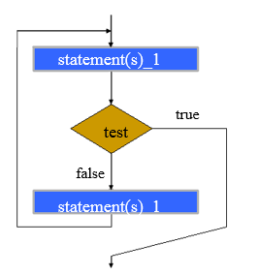
Types of Statements
General Loop Statements
loop
statements_1;
exit when test;
statements_2;
end loop;

Slide 133
Types of Statements
For Statement
for loop_var in low_val .. high_val
loop
statement(s);
end loop;

Slide 134
Types of Statements
Types of Statements
For Statement
for i in -1 .. 10 loop
PUT(i); NEW_LINE;
end loop;
for i in 1 .. 10 loop
PUT(i); NEW_LINE;
end loop;
for i in 2 .. n-1 loop
PUT(i); NEW_LINE;
end loop;

Slide 135
Types of Statements
Types of Statements
While Statement
while test loop
statement(s);
end loop ;

Slide 136
Types of Statements
Types of Statements
While Statement
While loops may be designed as a repeat structure, to execute at least once
j := -1;
while (j < 0) loop
put (“Enter positive j: );
get (j); skip_line;
end loop;

Slide 137
Types of Statements
Types of Statements
While Statement
A while loop may not execute at all
tot := 0;
PUT("Enter j (-1 to exit): ");
GET(j); SKIP_LINE;
while (j /= -1) loop
tot := tot + j;
PUT("Enter j (-1 to exit): ");
GET(j); SKIP_LINE;
end loop;
PUT("Total is "); PUT(tot); NEW_LINE;

Slide 138
000 -- filename: ifInteger.adb
001 with Ada.Text_IO; use Ada.Text_IO;
002 with Ada.Integer_Text_IO; use Ada.Integer_Text_IO;
003 procedure testrange is
004 Var : Integer;
005 begin
006 loop
007 Put ("Enter an Integer number to confirm its range:");
008 Get(Var);
009 case Var is
010 when Integer'First .. -1 =>
011 Put_Line ("It is a negative number");
012 when 1 .. Integer'Last =>
013 Put_Line ("It is a positive number");
014 when others =>
015 Put_Line ("It is 0");
016 end case;
017 exit when Var = 0;
018 end loop;
019 end testrange;

Slide 139
000 -- filename: ifInteger.adb
001 with Ada.Text_IO; use Ada.Text_IO;
002 with Ada.Integer_Text_IO; use Ada.Integer_Text_IO;
003 procedure testrange is
004 Var : Integer;
005 begin
006 for i in 1..10 loop
007 Put ("Enter an Integer number to confirm its range:");
008 Get(Var);
009 case Var is
010 when Integer'First .. -1 =>
011 Put_Line ("It is a negative number");
012 when 1 .. Integer'Last =>
013 Put_Line ("It is a positive number");
014 when others =>
015 Put_Line ("It is 0");
016 end case;
017 exit when Var = 0;
018 end loop;
019 end testrange;

Slide 140
000 -- filename: ifInteger.adb
001 with Ada.Text_IO; use Ada.Text_IO;
002 with Ada.Integer_Text_IO; use Ada.Integer_Text_IO;
003 procedure testrange is
004 Var : Integer;
005 begin
006 while Var /= 0 loop
007 Put ("Enter an Integer number to confirm its range:");
008 Get(Var);
009 case Var is
010 when Integer'First .. -1 =>
011 Put_Line ("It is a negative number");
012 when 1 .. Integer'Last =>
013 Put_Line ("It is a positive number");
014 when others =>
015 Put_Line ("It is 0");
016 end case;
017 end loop;
018 end testrange;

Slide 141
Structuring Programs
Mechanisms to control complexity
Abstraction
Modularization
Encapsulation

Slide 142
Structuring Programs
Modularity
Partition system into modules
Reduce complexity, easier development/maintenance
Parallel development, divide programming job for teams
Ada modules
Subprograms: procedures, functions
Packages

Slide 143
Procedures
declaration
procedure name (arguments) is
-- comment explaining purpose
constant definitions
variable definitions
procedure definitions
begin --name
statements
end name;
definition
defined for use in this
procedure only

Slide 144
Procedures
procedure display is
-- display a number
num : integer;
begin -- show_answer
num:= 71;
new_line;
put(“the number of students is :”);
put(num);
new_line;
end display;

Slide 145
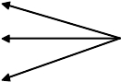
Procedures
Procedure Call
Write its name
Include arguments in brackets
begin
get_two_nums;
add_two_nums;
show_answer;
end;
procedure calls
Procedure must be visible
Declared earlier
Included via with

Slide 146
Procedures
Procedure call
Remember where we are in calling code
Transfer to called procedure
Set up storage for local variables
Associate parameters with values
Start execution at first statement of caller
Procedure finishes executing
Wind up called procedure
Return value through parameter
Dispose of storage
Pick up where left of in caller

Slide 147
Functions
Compute a single result, and Returns it directly
Function definition: like procedure, except
function instead of procedure as first word
Define data type of returned value
Include statements to return a value return statement;
Causes immediate termination of the function
The type of the returned value must match the type specified in the function definition
There cannot be an execution path through the function that does not include a return statement

Slide 148
Functions
Functions
Declaration
function function_name (parameter_specification) return return_type;
Execution
Function function_name (parameter_specification) return return_type is
declarations;
begin
statements;
return return_value;
end function_name ;

Slide 149
Functions
------------------------------------------
-- abs: absolute value
------------------------------------------
function abs (x : in INTEGER) return INTEGER is
begin -- abs
if x >= 0 then
return x;
else
y := abs (x);
return -x;
y := 10 * abs (-4);
end if;
y := abs (10 - abs (x));
end abs;

Slide 150
Procedures with Parameters
Parameters (argument to a procedure)
The procedure declaration shows the number and type of arguments
Formal parameter
The procedure call supplies specific arguments
Actual parameter
Parameter modes
Indicate how data may be communicated between calling and called procedure

Slide 151
Formal Parameters
Procedure declaration defines formal parameters
general rules for every call to procedure
Mode: in, out, in out
data type: integer, character, ...
internal name: (for use inside procedure)
In brackets after procedure name

Slide 152
Formal Parameters
Parameter Modes : Named from perspective of called procedure
in supplied to procedure by its caller
out provided by procedure to its caller
in out supplied to procedure by caller, (possibly) modified, and handed back

Slide 153
Formal Parameters
procedure adjust (
exam : in INTEGER;
mark : in out INTEGER;
)
is
-- local declarations
begin
-- statements
end adjust;
-- exam mark
-- overall subject mark

Slide 154
Actual Parameters
procedure call includes actual parameters
specific parameter values for this call
Can differ for each call
get_integer ( exam, 0, 50 );
get_integer ( number, 1, 5 );
get_integer ( number, low, low+4 );
begin
get_exam (exam);
get_lab (labs);
mark := exam + labs;
adjust (exam, mark);
PUT (mark);
print_grade (mark);
end;

Slide 155
Function or Procedure?
------------------------------------------
-- abs: absolute value
------------------------------------------
procedure abs (x : in INTEGER; -- argument
y :out INTEGER; -- abs(argument)
) is
begin -- abs
if x >= 0 then
y := x;
else
y := -x;
end if;
end abs;
abs(x, y);
abs (-4, temp);
y := 10 * temp;
-- y := abs (x);
-- temp:= abs(-4);
-- y := 10 * abs (-4);

Slide 156
Recursion
Writing procedures and functions which call themselves
Involves
Solving large problems
By breaking them into smaller problems
Of identical form
Eventually, a ”trivial” problem (the base case) is reached that can be solved immediately

Slide 157
Recursion
General algorithm
if stopping condition then
solve simple problem
else
use recursion to solve smaller problem(s)
combine solutions from smaller problem(s)
Iteration
Cognitive simple
Recursion
Is not as intuitive
Demanding on machine time and memory
Sometimes simpler than iteration

Slide 158
Recursion
Factorial
Write a function that, given n, computes n!
n!=1*2*3*…*(n-1)*n
Specification
Receive: n, an integer
Precondition: n >= 0 (0! = 1 and 1! = 1)
Return : n!

Slide 159
Recursion
Preliminary Analysis
Function Factorial_Iterative (N : Natural)
return Positive is
Result : Positive;
begin
Result := 1;
for Count in 2 .. N loop
Result := Result * Count;
end loop;
return Result;
end Factorial_Iterative;

Slide 160
Recursion
Analysis
Consider
n!=1*2*3*…*(n-1)*n
(n-1)!=1*2*3*…*(n-1)
n!=(n-1)!*n
We have defined the ! function in terms of itself

Slide 161
Recursion
A function that is defined in terms of itself is called self-referential, or recursive.
Recursive functions are designed in a 3-step process:
1.Identify a base case: an instance of the problem whose solution is trivial
Example: The factorial function has two base cases:
if n = 0 : n! = 1
if n = 1 : n! = 1

Slide 162
Recursion
Recursive functions are designed in a 3-step process:
2. Identify an induction step: a means of solving the non-trivial instances of the problem using one or more "smaller" instance of the problem.
Example: In the factorial problem, we solve the "big" problem using a "smaller" version of the problem:
n! = (n-1)! ∗ n
3. Form an algorithm from the base case and induction step.

Slide 163
Recursion
Ada Code
function Factorial (N : Natural) return
Positive is
begin --factorial
if N > 1 then
return N * Factorial(N-1);
else
return 1;
end if;
end Factorial;

Slide 164
Visibility
Scope of Declarations
Where does a given declaration apply?
What declarations apply at a given point?
Scope of a declaration
From where it is made, to the end of the subprogram that contains it

Slide 165
Visibility
Procedure P is
X : Integer;
procedure Q is
X : Integer; -- hides outer declaration
begin
X := 2; -- local decl. directly visible
P.X := 3; -- global decl. Visible, but not directly
end Q;
begin
Q;
end;
A declaration can be hidden from direct
visibility, but not hidden from all visibility,
and can be accessed using selector
syntax

Slide 166
Visibility
type T is (A, B, C, D);
procedure P (X : T );
type T1 is new T;
-- inherited P is visible
procedure P (X : T1 );
-- inherited P is hidden from all visibility
Some declarations are hidden from
all visibility, in particular once an
inherited declaration is overridden,
there is no way to name it:

Slide 167
1 with TEXT_IO; use TEXT_IO;
2 procedure main is
3 length : constant := 4;
4 str: string (1..length);
5 num : INTEGER;
6 procedure one (num,len :in INTEGER) is
7 str:string (1..10);
8 Begin --one
9 ... ... ... ...
10 end one;
11
X, Y : FLOAT;
13 procedure two (len : in INTEGER) is
14 X : INTEGER;
15 begin --two
16 ... ... ... ...
17 end two;
18 begin –main
19 ... ... ... ...
20 end main;

Slide 168
Visibility
Name | Line | one | two | main
PUT, etc | 1 | Y | Y | Y
length | 3 | Y | Y | Y
str | 4 | N | Y | Y
num | 5 | N | Y | Y
num | 6 | Y | N | N
Len | 6 | Y | N | N
Str | 7 | Y | N | N
X | 12 | N | N | Y
Y | 12 | N | Y | Y
len | 13 | N | Y | N
X | 14 | N | Y | N

Slide 169
Packages
Collection of resources
Encapsulated in one unit
Single library unit
Free-standing unit
Must contain its own declarations for everything it needs
Compiled on its own
Incorporated in other programs via ‘with’
Compilation order:
Library unit
Procedures that use it

Slide 170
Package Organization
Package specification show “what” it provides
Package body defines “how” it is implemented
Both are separate from the user’s program that uses the package

Slide 171
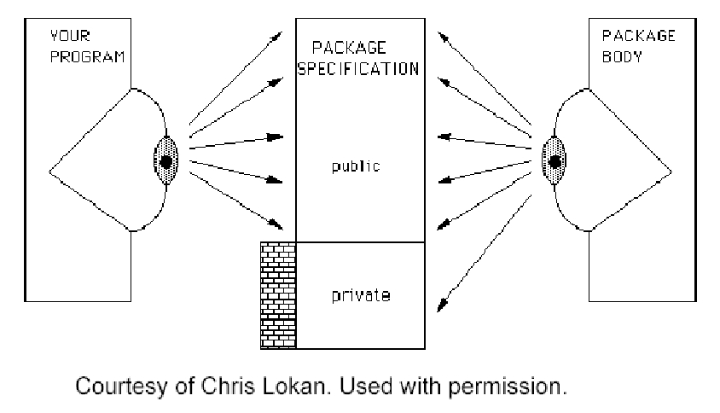
Package Organization

Slide 172
Package Specification
Public
What you need to know to use the package
Private
Implementation of data types
Package package_name is
declarations
private
type definitions
end package_name;
public portion
private portion

Slide 173
Private Types
package accounts is
type account is private; -- declaration comes later
procedure withdraw(an_account : in out account; amount : in money);
procedure deposit(an_account: in out account; amount : in money);
function create(initial_balance : money) return account;
function balance( an_account : account) return integer;
private -- this part of the package specification contains the full description.
type account is
record
account_no :positive;
balance :integer;
end record;
end accounts;

Slide 174
Package Body
Implementation of the resources provided by the package
All a user of the package needs to know is what the package provides.
The package is a "black box" to the user of the package.
The package body is not visible to a package user.

Slide 175
Package Body
package body packgae_name is
statements1;
[begin]
statements2;
end package_name;

Slide 176
Package Decaration
Specification.ads
package PLANIMETRY is
type length is digits 5 range 0.0 .. 1.0E10;
type area is digits 5 range 0.0 .. 1.0E20;
function
function
function
function
area_rectangle (L,H : length) return area;
area_circle (R : length) return area;
area_triangle (B,H : length) return area;
circumf_circle (R : length) return length;
end PLANIMETRY;

Slide 177
Package Body
Specification.adb
package body PLANIMETRY is
PI : constant := 3.1415926536;
function area_rectangle (L,H : length) return area is
begin
return area(L) * area(H);
end;
function area_circle (R : length) return area is
begin
return PI * area(R) ** 2;
end;

Slide 178
Package Body
Specification.adb
function area_triangle (B,H : length) return area is
begin
return area(B) * area(H) / 2.0;
end;
function circumf_circle (R : length) return length is
begin
return 2.0 * PI * R;
end;
end PLANIMETRY;

Slide 179
Using Packages
To use a package element
package.element
Ada.Text_Io.put (item => “abc”);
Ada.Text_Io.new_line;
int_io.put (mark, width => 1);
planimetery.area_circle (2.0);

Slide 180
Using Packages
Use allows package to be omitted
use Ada.Text_io, int_io, planimetry;
…
put (“abc”);
new_line;
put (mark, width => 1);
area_circle (2.0);

Slide 181
Using Packages
with TEXT_IO, PLANIMETRY;
procedure main is
use TEXT_IO;
... declarations
L : PLANIMETRY.length;
H : PLANIMETRY.length;
A : PLANIMETRY.area;
R : PLANIMETRY.length;
begin
R := ... ;
A := PLANIMETRY.area_circle (R);
end main;
-- length
-- height
-- area
-- radius

Slide 182
Exercise
Write a simple package that contains
A function to add two integers.
A procedure to multiply two integers.
Write an Ada95 program that uses the package

Slide 183
Input and Output
The standard Ada libraries provide several Input/Output facilities, each one adapted to specific needs
Text_IO
Sequential_IO
Direct_IO
Stream_IO
The programmer must choose the adequate package depending on the application needs.

Slide 184
Input and Output
Following properties of the data handled by the application should be considered:
Data contents: plain text, or binary data?
Accessing the data: random access, or sequential access?
Medium: data file, console, network/data-bus?
Data structure: homogeneous file (sequence of the same data field), heterogeneous file (different data fields)?
Data format: adherence to an existing data format, or the application can freely choose a new one

Slide 185
Input and Output
I/O Package
Text_IO can handle just textual data, but it is enough for handling the command-line console
Sequential_IO is lean and easy to use but cannot be used by applications requiring random data access;
Direct I/O is used for random access files which contain only elements of one specific type, you can position the file pointer to any element of that type（definite）
Stream_IO is very powerful and can handle complex data structures, but can be heavier than other packages;
Notes:
Stream_IO： allows you to mix objects from different element types in one sequential file
Sequential_IO： you can choose between definite and indefinite element types but you have to read and write the elements one after the other.

Slide 186
Input and Output
Simple heuristic for choosing an I/O Package
Data access | Plain text | Binary Data
 |  | Homogeneous | Heterogeneous
Sequential | Text_IO | Sequential_IO | Stream_IO
Random | Text_IO | Direct_IO | Stream_IO

Slide 187
File
External Files
Values input from the external environment of the program
Output to the external environment
File
Name (string)
Form (string that give system defined characteristics such as access rigthts)

Slide 188
File
File_type
Associates an object through which the program can access the external file
My_File : Ada.Text_IO.File_Type;
File_mode
For Sequential_IO, Text_IO, and Stream_IO
type File_Mode is (In_File, Out_File,Append_File);
For Direct_IO
type File_Mode is (In_File, Inout_File,Out_File);

Slide 189
File
procedure Create ( File : in out File_Type;
Mode : in File_Mode := Out_File;
Name : in String := "";
Form : in String := "");
procedure Open (File : in out File_Type;
Mode : in File_Mode;
Name : in String;
Form : in String := "");
procedure Close (File : in out File_Type);
procedure Delete (File : in out File_Type);
procedure Reset (File : in out File_Type);

Slide 190
with Ada.Text_IO; use Ada.Text_IO; procedure Read_And_Write_File_Line_By_Line is Input, Output : File_Type; begin Open (File => Input, Mode => In_File, Name => "input.txt"); Create (File => Output, Mode => Out_File, Name => "output.txt"); loop declare Line : String := Get_Line (Input); begin -- You can process the contents of Line here. Put_Line (Output, Line); end; end loop; Close (Input); Close (Output);
exception when End_Error => if Is_Open(Input) then Close (Input); end if; if Is_Open(Output) then Close (Output); end if; end Read_And_Write_File_Line_By_Line;

Slide 191
with Ada.Sequential_IO; procedure Read_And_Write_File_Character_By_Character is package Char_IO is new Ada.Sequential_IO (Character); use Char_IO; Input, Output : File_Type; Buffer : Character; begin Open (File => Input, Mode => In_File, Name => "input.txt"); Create (File => Output, Mode => Out_File, Name => "output.txt"); loop Read (File => Input, Item => Buffer); Write (File => Output, Item => Buffer); end loop; Close (Input); Close (Output);
exception when End_Error => if Is_Open(Input) then Close (Input); end if; if Is_Open(Output) then Close (Output); end if; end Read_And_Write_File_Character_By_Character;

Slide 192
with Ada.Text_IO; use Ada.Text_IO; with Ada.Text_IO.Text_Streams; use Ada.Text_IO.Text_Streams; procedure Using_Text_Streams is Input, Output : File_Type; Buffer : Character; begin Open (File => Input, Mode => In_File, Name => "input.txt"); Create (File => Output, Mode => Out_File, Name => "output.txt"); loop Buffer := Character'Input (Stream (Input)); Character'Write (Stream (Output), Buffer); end loop; Close (Input); Close (Output);
exception when End_Error => if Is_Open(Input) then Close (Input); end if;
if Is_Open(Output) then Close (Output); end if; end Using_Text_Streams;

Slide 193
Summary
Overview of Ada Language
Ada Syntax
Data Types
Types of Statements
Subprograms
Package
Input and Output

Slide 194
Thank you!

